Slide 1
Web Services

Slide 2
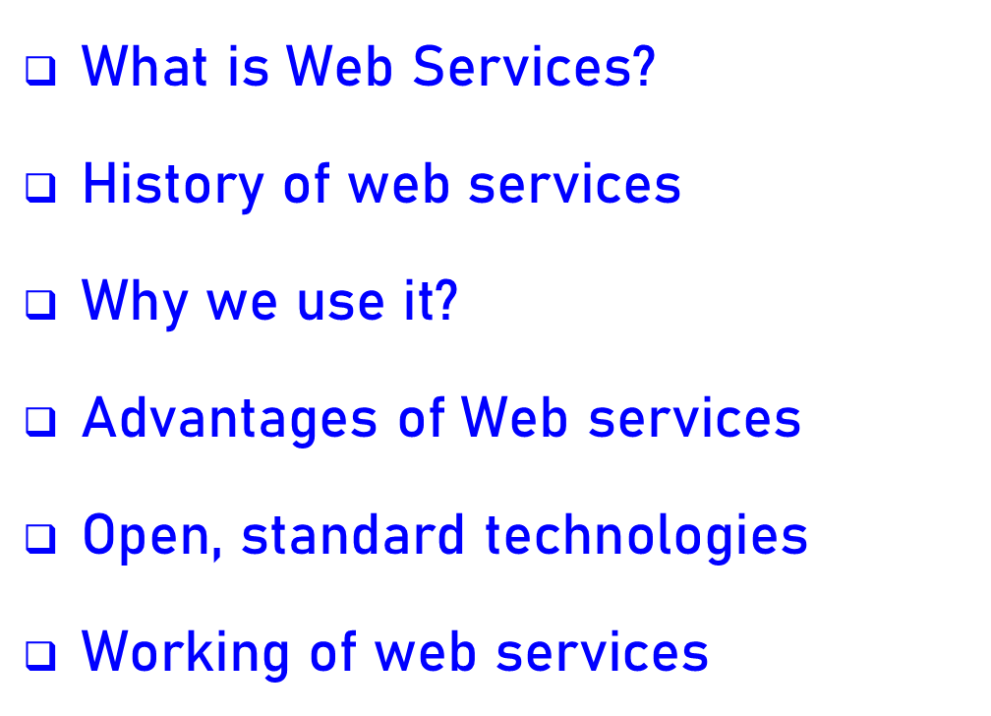
Contents

Slide 3
What is web service?
Service available over the internet.
Enable communication between applications over the web.
uses a standardized XML messaging system. XML is used to encode all communications to a web service.
A web service is a collection of open protocols and standards used for exchanging data between applications or systems.

Slide 4
A web service comprises these essential functions:
Available over the internet or intranet networks
Standardized XML messaging system
Independent of a single operating system or programming language
Self-describing via standard XML language
A web service supports communication among numerous apps with HTML, XML, WSDL, SOAP, and other open standards. XML tags the data, SOAP transfers the message, and WSDL describes the service’s accessibility.

Slide 5
History of web services
Structured Programming
Object-Oriented Programming
Distributed Programming
Electronic data exchange
World wide web
Web Services

Slide 6
Continue…
Hewlett-Packard’s e- speak in 1999
Was an enabler for e-services
Microsoft introduced the name “web services” in June 2000.

Slide 7
Why we use web services
Provides a standard protocols/format for communication.
Platform Independent communication.

Slide 8
Advantages of web services
Open, test-based standards
Modular approach
Inexpensive to implement
Reduce the cost of enterprise application integration
Incremental implementation

Slide 9
Open, Standard Technologies
XML- Extensible Markup Language (XML) is used to describe data such that it can be exchanged between applications and platforms.
SOAP- messaging protocol for transporting information and instructions between applications (uses XML)
WSDL- a standard method of describing web services and their specific capabilities(XML).
UDDI-defines XML- based rules for building directories in which companies advertise themselves and their web services.

Slide 10
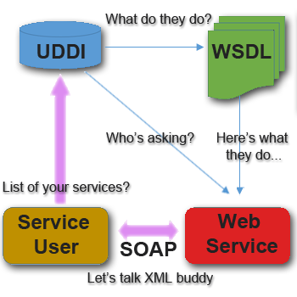
Working of web services

Slide 11
Thank
You

